Slide 1
Adversarial Search

Slide 2


Slide 3
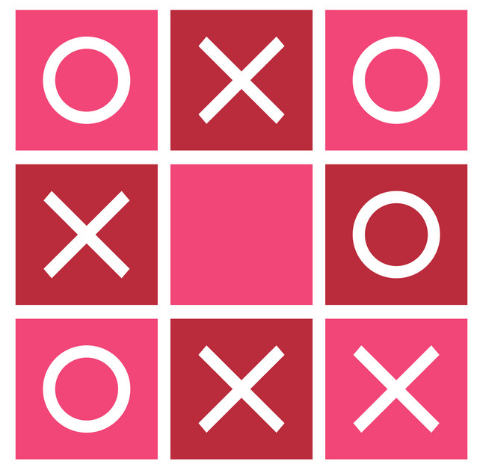
Adversarial Search
How can a computer play games with us?
Answer: By generating graphs
Let’s see a scenario:

Slide 4
Lets do some renaming
The Computer/ AI Agent: MAX
The Human Player : MIN

Slide 5
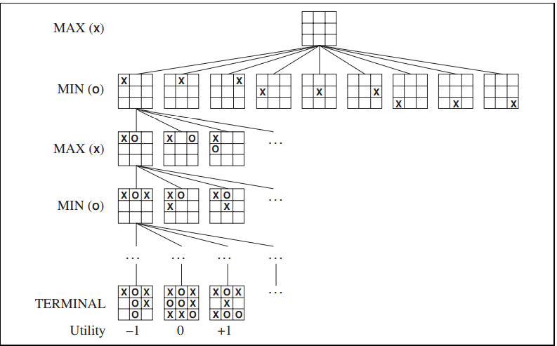
Max will choose a move here
Based on the values over here
A
0
10
100

Slide 6
O | X
 | X
O | O | X
O | X
 | X | X
O | O | X
O | X | X
 | X
O | O | X
O | X
X | X
O | O | X

Slide 7
Lets see a smaller and more general example
MAX
A
a1
a2
a3
MIN
B
C
D
b1
b2
b3
c2
d1
d2
d3
c1
MAX(BUT
END/CUTOFF
c3
3
12
8
14
5
2
2
4
6

Slide 8
Lets see a smaller and more general example
3
2
2
MAX
A
So action a1 will be taken by MAX
a1
a2
a3
14
5
2
B
C
MIN
12
3
8
2
4
6
D
b1
b2
b3
c2
d1
d2
d3
c1
MAX(BUT
END/CUTOFF
c3
3
12
8
14
5
2
2
4
6
Notes:
MaxNodeFunction:
1. Take all actions possible by MAX and generate MIN nodes
2. Run the MinNodeFunction on each Min Node : A value will be returned
3. Select the highest value and return it above if there is a parent.
4. If there is no parent then this node is the parent, select the action and return it.
MinNodeFunction:
1. Take all actions possible by MIN and generate MAX nodes
2. Run the MaxNodeFunction on each Max Node : A value will be returned
3. Select the lowest value and return it above if there is a parent.
4. If there is no parent then this node is the parent, select the action and return it.//usually min nodes are never found in graphs as parents

Slide 9
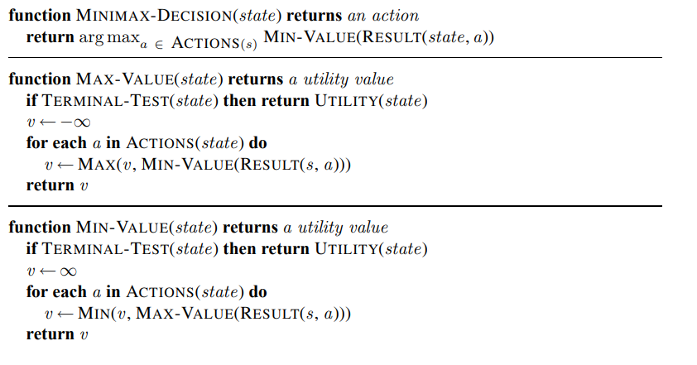
The Algorithm

Slide 10
Alpha Beta Pruning
For a Min Node :
Alpha : This is the value which its parent has received so far.
Beta : This is the value which I have received so far.
For a Max Node :
Alpha : This is the value which I have received so far.
Beta : This is the value which its parent has received so far.

Slide 11
Alpha Beta Pruning
Remember:
A max node pushes higher values upward.
A min node pushes lower values upward
[3, -inf]
[-inf, +inf]
MAX
A
3
2
[-inf, +inf]
a1
a2
a3
[-inf, 3]
[3, 2]
[3, -inf]
[3, 5]
[3, -inf]
[3, 14]
[3, 2]
B
3
12
2
C
MIN
8
D
14
5
2
b1
b2
b3
c2
d1
d2
[-inf, +inf]
d3
c1
c3
MAX(BUT
END/CUTOFF
3
12
8
14
5
2
2
4
6

Slide 12
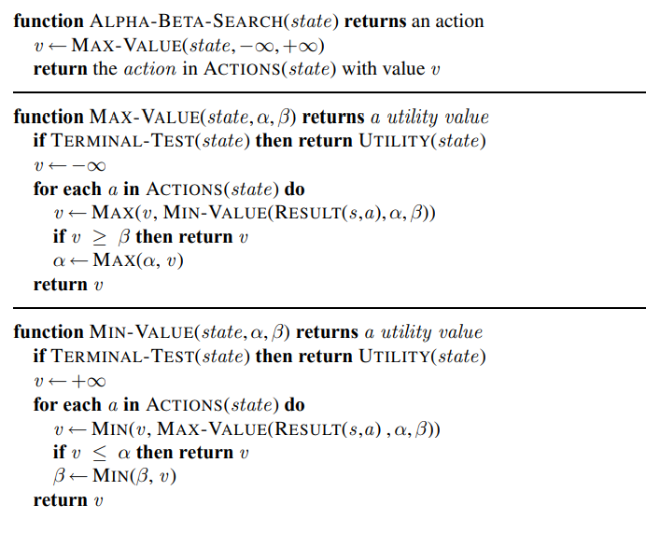

Slide 13
What can be a good utility function/heuristic?
Depends on your creativity.
Must ensure the following:
If the game state is better for MAX – it will return a higher value
If the game state is bad for MAX – it will return a lower value
For tic tac toe :
In Tic-Tac-Toe, a possible heuristic evaluation function for the current board position is:
+100 for EACH 3-in-a-line for computer.
+10 for EACH two-in-a-line (with a empty cell) for computer.
+1 for EACH one-in-a-line (with two empty cells) for computer.

Slide 14
Game Play
Computer
You
 | X
 | X
 | X | O
A
a1
 | X | O
 | X | O
X
 | X | O
X
 |  | O
 | X | O
X
a2
a3
B
C
D
b1
b2
b3
c2
d1
d2
c1
d3
A
c3
3
12
8
a1
a2
a3
Continues until win, loss, or draw!
B
C
14
D
5
2
2
4
6
b1
b2
b3
c2
d1
d2
c1
d3
c3
3
12
8
14
5
2
2
4
6

Slide 15
Example Code: Tic Tac Toe.
Click here for the sample code

